Slide 1
STUDENT FEEDBACK REVIEW SYSTEM Domain Name: Data Mining
PRESENTED BY,
KEERTHANA S
20UIT062
III/VI/A

Slide 2

CONTENT
PROJECT TITLE
OVERVIEW OF DOMAIN
ABSTRACT
OBJECTIVE
EXISTING AND PROPOSED SYSTEM
DETAILS OF THE TOOLS FOR IMPLEMENTATION
JUSTIFICATION OF THE TOOLS
BASE PAPER

Slide 3

OVERVIEW OF THE DOMAIN
The Student Feedback System is a management information system for education establishments to manage student data. Student Feedback Systems provide capabilities for selecting particular subject for feedback and generate the report automatically, build student details, student-related data needs in a college.
An Student Feedback System is an automatic feedback generation system that provides the proper feedback to the staffs as per the categories like always, poor, usually, very often, sometimes. In the existing system students can give feedback about the lecturers by doing manually. By this process student can give feedback in online system without wasting his time in writing. After giving feedback by every student papers are collected by the faculty and calculated the overall grade for each subject and each lecturer.

Slide 4
ABSTRACT
The student feedback review system using Python is a powerful tool that can help educational institutions to enhance the quality of education and improve student satisfaction. This system leverages data mining techniques to analyze feedback from students and provide insights that can be used to make informed decisions. The purpose of this system is to provide a comprehensive solution for collecting, analyzing, and utilizing student feedback in a way that is efficient, effective, and user-friendly.
The goals of the student feedback review system using Python include improving the overall quality of education, enhancing student engagement and satisfaction, and providing valuable insights to educators and administrators. By leveraging the power of data mining, this system can help educational institutions to identify areas where improvements are needed, measure the effectiveness of interventions, and make data-driven decisions that benefit both students and educators.

Slide 5
OBJECTIVE
The student feedback review system that we will build aims to collect `students about their experience in a particular course. The system should be able to collect data about various aspects of the course such as the quality of teaching, course content, assessments, etc. The feedback collected should be analyzed to provide insights into the strengths and weaknesses `of the course. Based on this analysis, the feedback can be used to improve the course content and teaching methodology.`

Slide 6
EXISTING SOLUTION
Currently, most educational institutions rely on paper-based surveys or online forms to collect student feedback. While these methods are convenient and accessible, they have several limitations. For example, students may not take the surveys seriously or may not provide honest feedback due to fear of retaliation. Additionally, analyzing the data collected from these surveys can be time-consuming and inefficient.
Moreover, these methods do not provide real-time feedback, which means that educators cannot make immediate adjustments to their teaching methods based on student feedback. This can lead to a delay in addressing issues and improving the quality of education.

Slide 7
PROPOSED SYSTEM
The proposed student feedback review system using Python data mining offers several unique features and benefits that improve upon existing methods. Firstly, the system uses advanced data mining techniques to analyze student feedback, providing more accurate and insightful results. This allows educational institutions to identify areas for improvement and make data-driven decisions to enhance the quality of education. Additionally, the system is highly customizable and can be tailored to meet the specific needs of each institution. This ensures that the feedback collected is relevant and actionable, leading to better outcomes for both students and educators.
Furthermore, the system provides real-time feedback to both students and educators, allowing for immediate action to be taken to address any issues or concerns. This promotes a culture of continuous improvement and fosters a positive learning environment. Overall, the proposed system offers a comprehensive solution to the challenges faced by educational institutions in collecting and analyzing student feedback, and has the potential to significantly improve the quality of education.

Slide 8



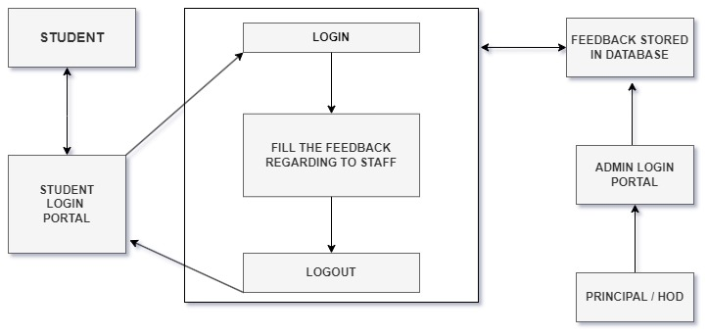
ARCHITECTURE

Slide 9


TOOLS USED
Visual code studio:
Visual Studio Code is a free source-code editor made by Microsoft for Windows, Linux and macOS. Visual Studio Code is a streamlined code editor with support for development operations like debugging, task running, and version control.
Python:
Python is a general-purpose programming language that is used for a wide variety of tasks, including web development, data science, systems programming, and scientific computing. It is a powerful and versatile language that is easy to learn and use.

Slide 10


XAMPP is a free and open-source cross-platform web server solution stack package developed by Apache Friends, consisting of the Apache HTTP Server, MySQL database, PHP and Perl programming languages. XAMPP is designed to be a complete, easy-to-install Apache distribution containing MariaDB, PHP and Perl. It is available for Windows, macOS, Linux and Solaris.
MySQL is a relational database management system (RDBMS) that is free and open-source. It is one of the most popular RDBMSs in the world, and is used by a wide variety of websites and it is based on Structured Query Language (SQL), which is a standard language for interacting with databases. SQL allows you to create, read, update, and delete data in a database.

Slide 11
THANK YOU

